Slide 1
Machine Learning for data science and business intelligence – 8IAR403
By Kévin Bouchard Ph.D.
Professor in artificial intelligence & machine learning
Laboratoire d'Intelligence Ambiante pour la reconnaissance d'activités (LIARA)
Université du Québec à Chicoutimi
www.Kevin-Bouchard.ca

Slide 2
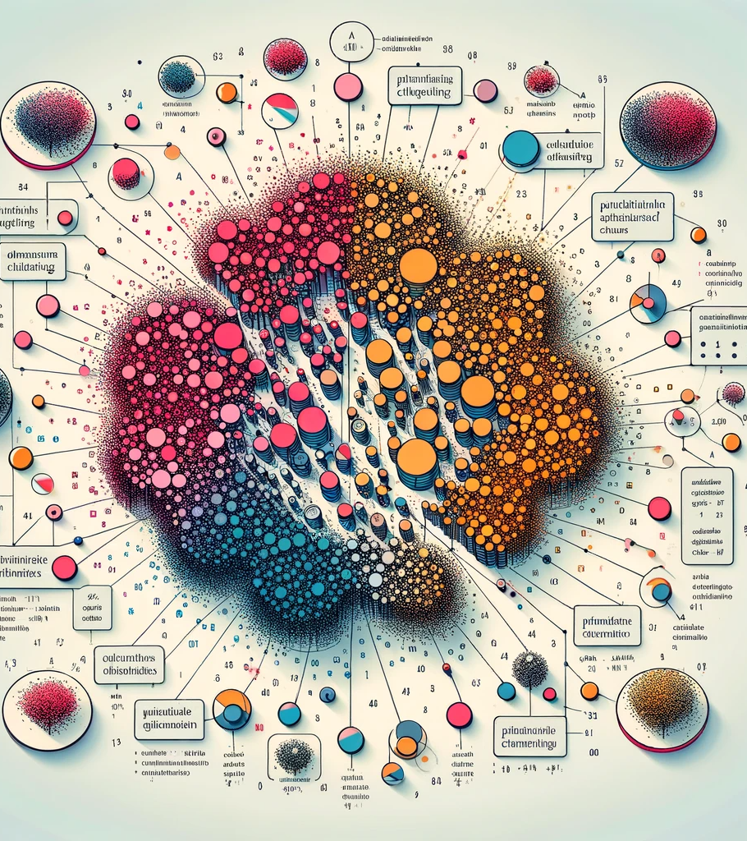
Summary of lesson #17
You will learn about:
Clustering and the main library to perform it
Various partition-based clustering algorithms and how to find the number of clusters
Distribution-based clustering

Slide 3
Clustering
Clustering is a machine learning technique that involves grouping a set of objects in such a way that objects in the same group, or cluster, are more similar to each other than to those in other groups
It's a method of unsupervised learning, and it is commonly used for statistical data analysis used in many fields
Nevertheless, the groups could potentially represent underlying classes!
3

Slide 4
Type of clustering
Partitioning Methods: Divides the dataset into a set of clusters without hierarchical structure
Hierarchical Clustering:
Builds a multilevel hierarchy of clusters by creating a cluster tree (dendrogram)
It can be either agglomerative (bottom-up) or divisive (top-down)
Density-Based Methods: Clusters are defined as areas of higher density than the remainder of the data set
Distribution based Clustering: Assumes a model for each cluster and tries to find the best fit of that model to each other
Grid-Based Methods: Divides the data space into a finite number of cells that form a grid and then performs clustering on the grid structure (out of our scope)

Slide 5
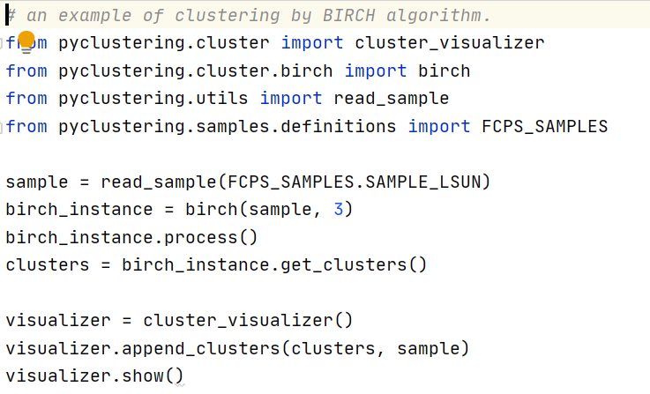
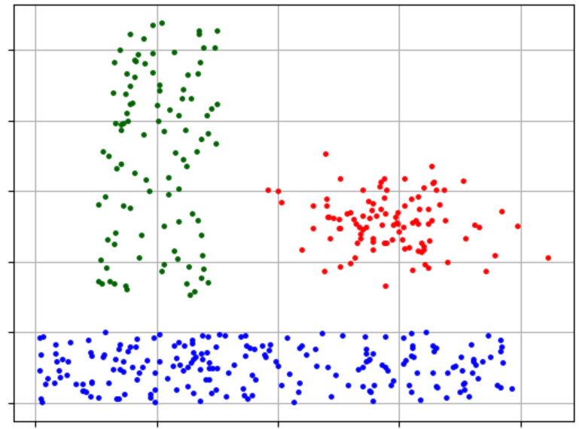
Library
Scikit-Learn offers the most popular clustering methods, but it is far from complete
We can also check pyclustering which offer more options
https://pyclustering.github.io/docs
However, the documentation is rather limited
Here is an example:

Slide 6
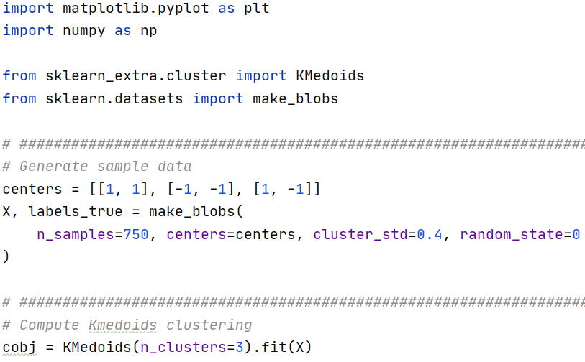
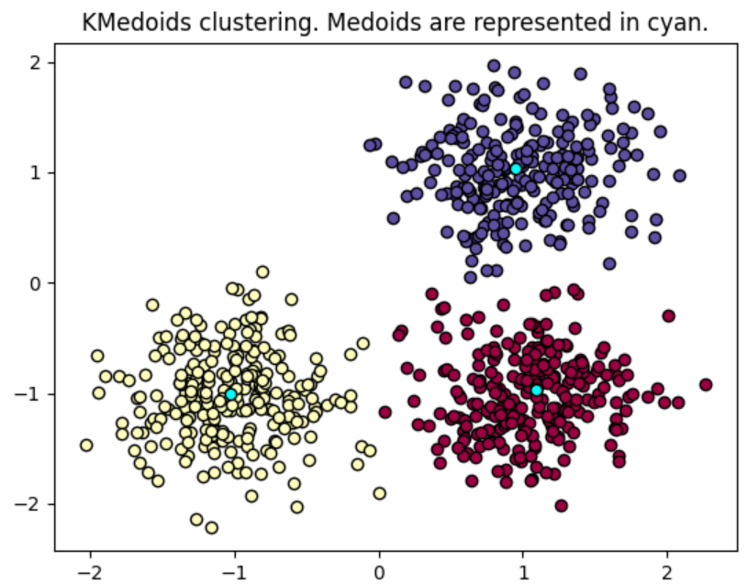
Library
A second option is to use Scikit-Learn Extra (SKE)
Albeit more limited, SKE offers a few algorithms that don’t meet the inclusion criteria of Scikit-Learn
https://scikit-learn-extra.readthedocs.io/en/latest/user_guide.html
For clustering, they include K-Medoids, CLARA and common-nearest-neighbors clustering

Slide 7
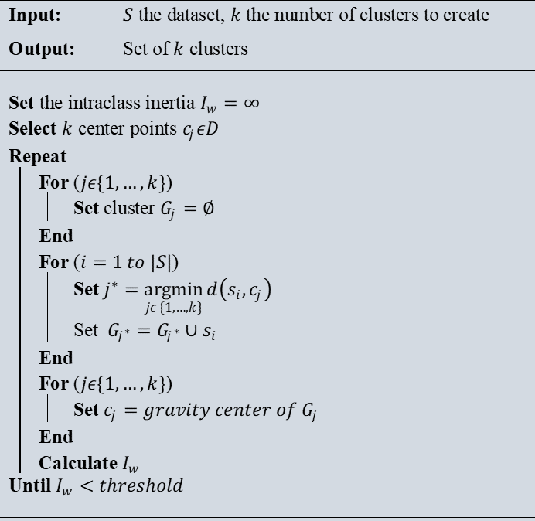
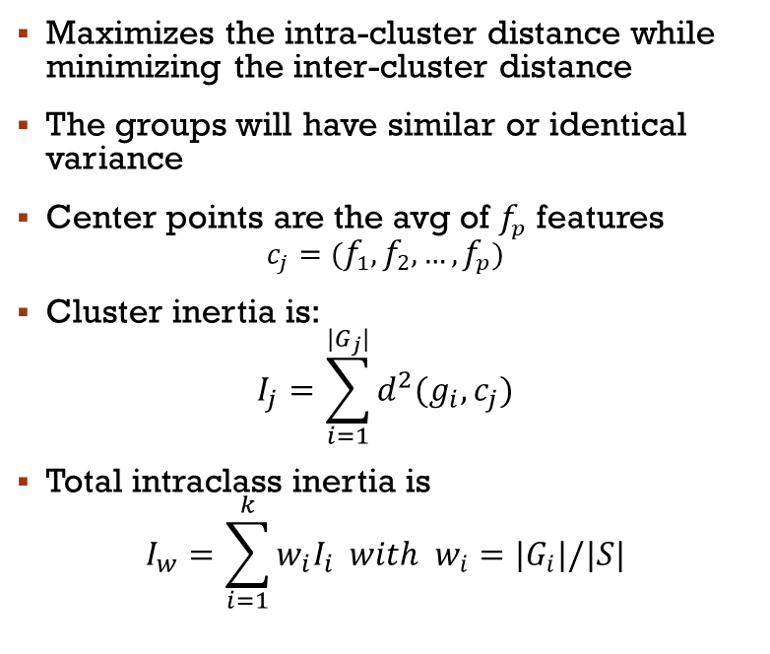
K-Means
Maximizes the intra-cluster distance while minimizing the inter-cluster distance
The groups will have similar or identical variance
Center points are the avg of $f_{p}$ features
$$c_{j}=(f_{1},f_{2},…,f_{p})$$
Cluster inertia is:
$$I_{j}=\sum_{i=1}^{{|G}_{j}|}{d^{2}(g_{i},c_{j})}$$
Total intraclass inertia is
$$I_{w}=\sum_{i=1}^{k}{w_{i}I_{i}} with w_{i}={|G}_{i}|/|S|$$
Notes:
Scale bien bcp data
Wi=proportion d’instances dans le cluster i

Slide 8
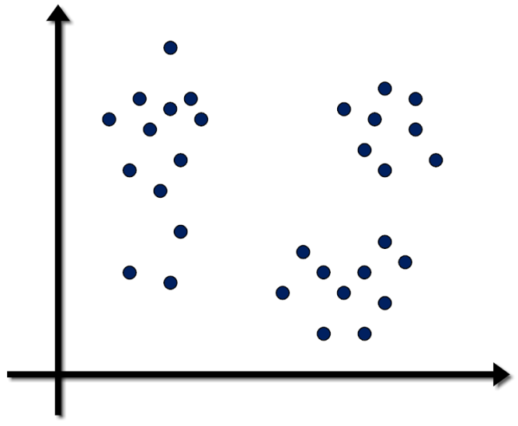
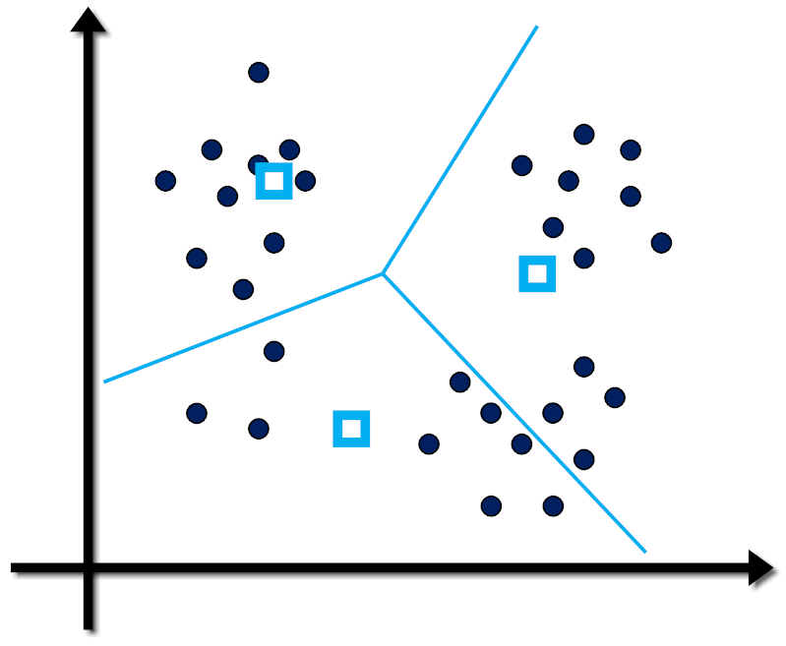
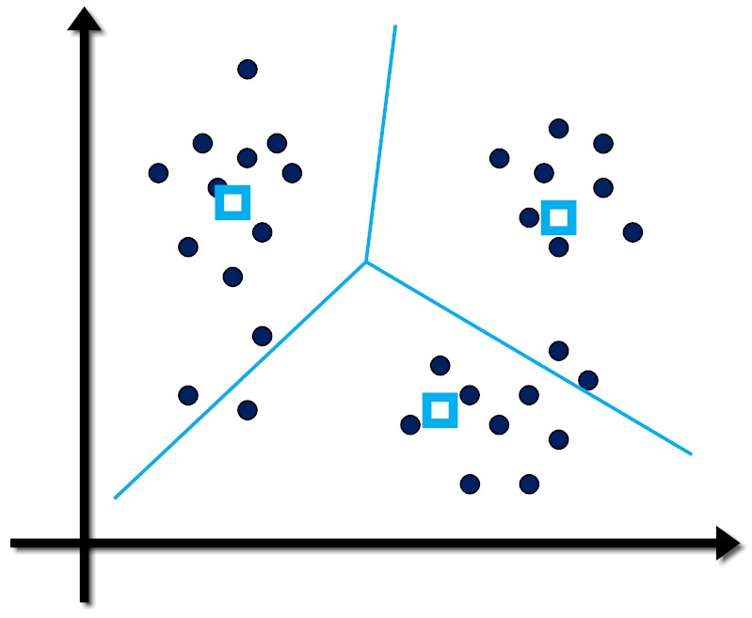
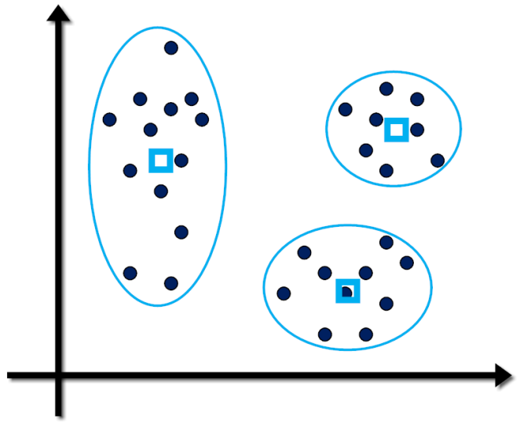
Notes:
Converge toujours, mais pas de garantie que c’es minimum global
Dépend largement de k et des centroids initiaux
Très rapide… K-means ++ pour meilleur init de centroids (init=‘k-means++’

Slide 9
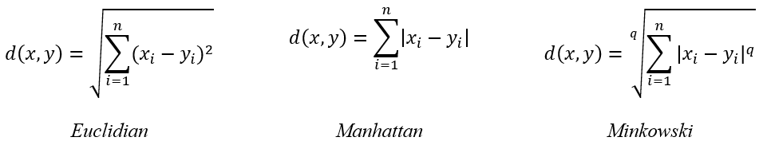

Distances
The distance measure should respect these four properties:
$d\left(x,y\right)≥0$
$d\left(x,y\right)=0 iff x=y$
$d\left(x,y\right)=d\left(y,x\right)$
$d\left(x,z\right)≤d\left(x,y\right)+d(y,z)$
Popular distances include:

Slide 10
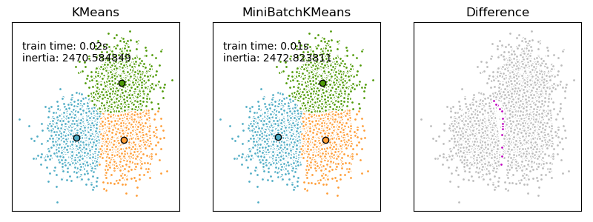
MinibatchKMeans
For datasets that doesn’t fit in memory
Faster, but lower quality
It also need a stop condition since it never converge (max iterations, variance, etc.)

Slide 11



Other partitioning algorithms
Partitioning Around Medoids (PAM)
PAM minimizes the sum of dissimilarities between data points and a chosen point called a medoid
Less sensitive to outliers
Clustering LARge Applications (CLARA)
Extension of PAM, specifically designed to handle large datasets efficiently
CLARA works by selecting a random sample of the data, applying PAM to the sample, and repeating this process multiple times

Slide 12
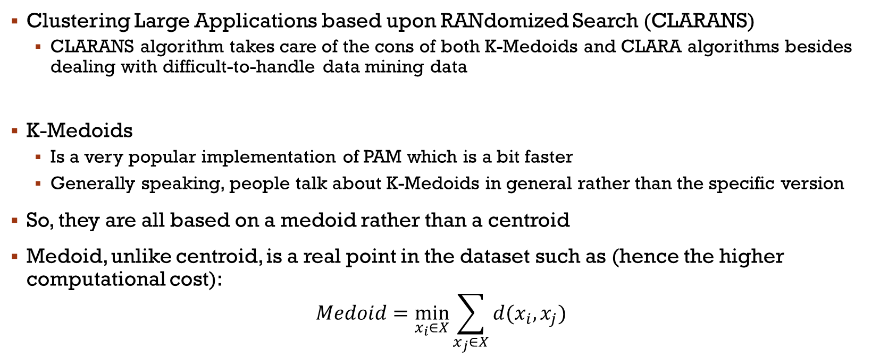
Other partitioning algorithms
Clustering Large Applications based upon RANdomized Search (CLARANS)
CLARANS algorithm takes care of the cons of both K-Medoids and CLARA algorithms besides dealing with difficult-to-handle data mining data
K-Medoids
Is a very popular implementation of PAM which is a bit faster
Generally speaking, people talk about K-Medoids in general rather than the specific version
So, they are all based on a medoid rather than a centroid
Medoid, unlike centroid, is a real point in the dataset such as (hence the higher computational cost):
$$Medoid=\min_{x_{i}∈X}{\sum_{x_{j}∈X}{d(x_{i},x_{j})}}$$

Slide 13
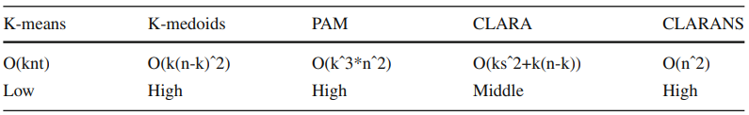
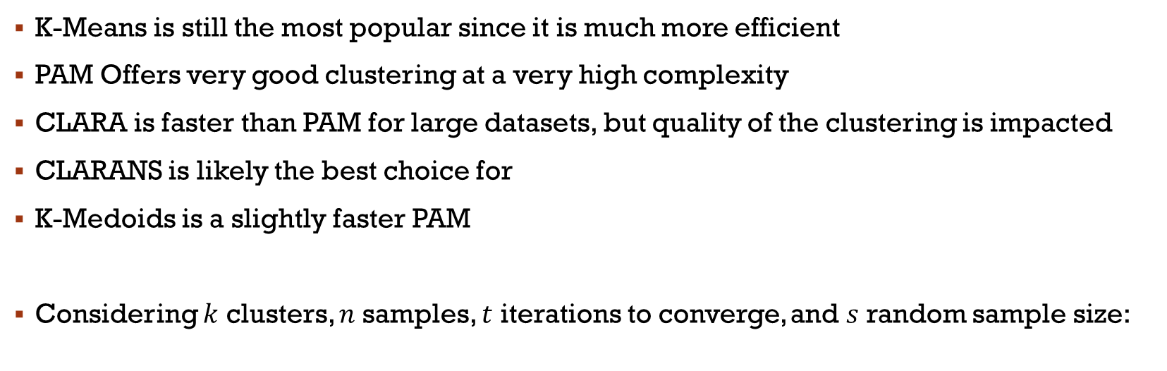
Other partitioning algorithms
K-Means is still the most popular since it is much more efficient
PAM Offers very good clustering at a very high complexity
CLARA is faster than PAM for large datasets, but quality of the clustering is impacted
CLARANS is likely the best choice for
K-Medoids is a slightly faster PAM
Considering $k$ clusters, $n$ samples, $t$ iterations to converge, and $s$ random sample size:

Slide 14
CLARANS
Select ‘k’ random data points and label them as medoids for the time being.
Select a random point say ‘a’ from the points picked in step (1), and another point say ‘b’ which is not included in those points.
We would already have the sum of distances of point ‘a’ from all other points since that computation is required for selecting the points in step (1). Perform similar computation for point ‘b’.
If the sum of distances from all other points for point ‘b’ turns out to be less than that for point ‘a’, replace ‘a’ by ‘b’.
PART II → Next slide

Slide 15
CLARANS
The algorithm performs such a randomized search of medoids ‘x’ times where ‘x’ denotes the number of local minima computed, i.e. number of iterations to be performed, which we specify as a parameter. The set of medoids obtained after such ‘x’ number of steps is termed as ‘local optimum’.
A counter is incremented every time a replacement of points is made. The process of examining the points for possible replacement is repeated till the counter does not exceed the maximum number of neighbors to be examined (specified as a parameter).
The set of medoids obtained when the algorithm stops is the best local optimum choice of medoids.

Slide 16
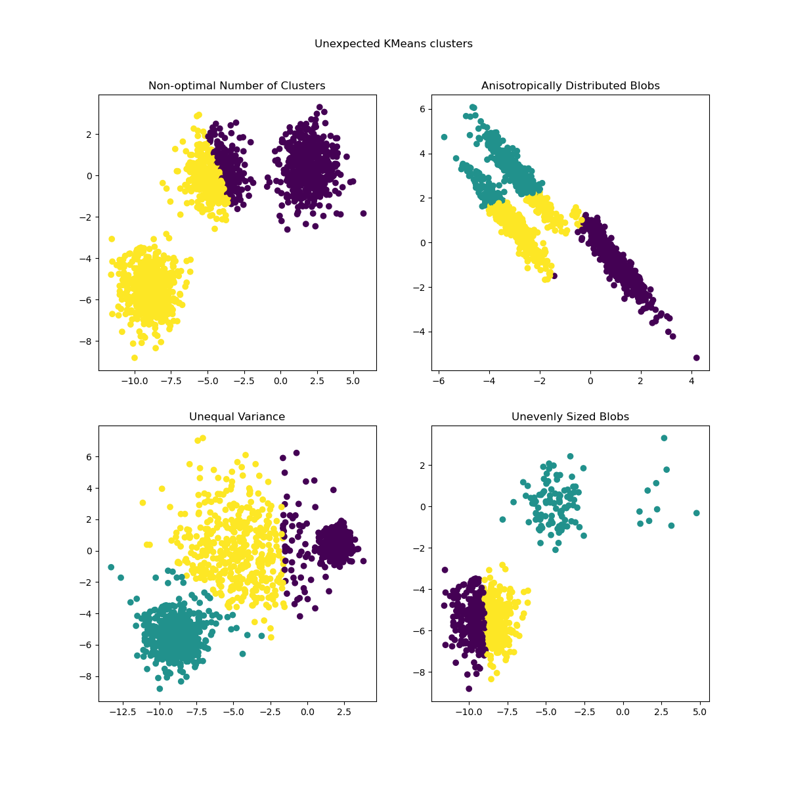
Limit of classic partitioning
There is a good example on Scikit-Learn library demonstrating the limits of partitioning:
https://scikit-learn.org/stable/auto_examples/cluster/plot_kmeans_assumptions.html
Notes:
We can address number of cluster (see next)
Unevenly too, by running a few times… with random cluster initialization
As anisotropic and unequal variances are real limitations of the k-means algorithm->other method… density & distribution

Slide 17
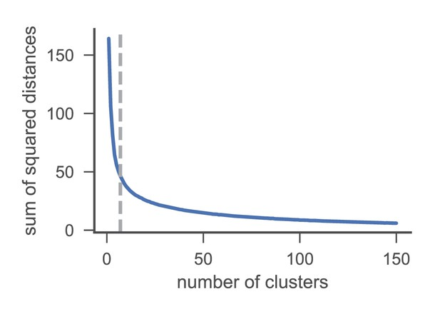
Elbow method
The method, from 1953, consists of plotting the explained variation as a function of the number of clusters
Then, we pick the elbow of the curve as the number of clusters to use
The same method can be used to choose the number of parameters in other data-driven models, such as the number of principal components to describe a data set
If you have label here, this would simply be optimization
This Photo by Unknown Author is licensed under CC BY

Slide 18
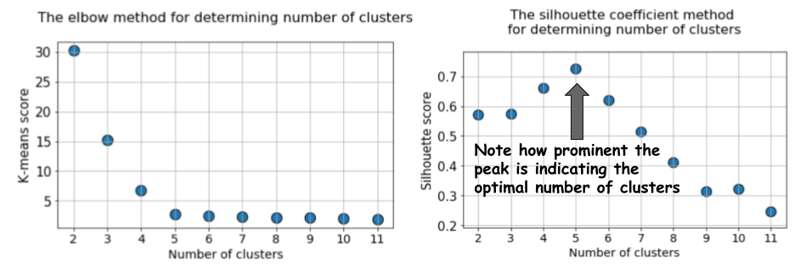
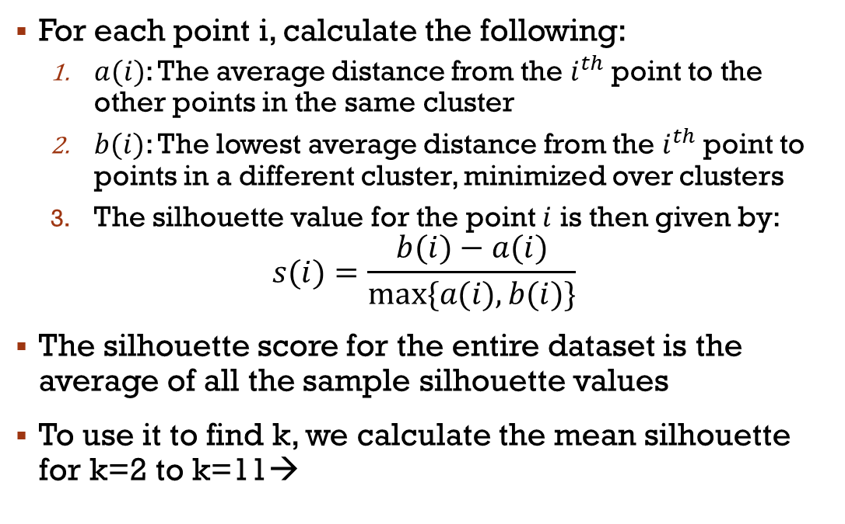
Other method to define K
For each point i, calculate the following:
$a(i)$: The average distance from the $i^{th}$point to the other points in the same cluster
$b(i)$: The lowest average distance from the $i^{th}$point to points in a different cluster, minimized over clusters
The silhouette value for the point $i$ is then given by:
$$s(i)=\frac{b(i)−a(i)}{max⁡\{a(i),b(i)\}}$$
The silhouette score for the entire dataset is the average of all the sample silhouette values
To use it to find k, we calculate the mean silhouette for k=2 to k=11→
*image from: https://www.kdnuggets.com/2019/10/clustering-metrics-better-elbow-method.html
Notes:
CODE
Dire pas juste pour trouver les cluster, mais aussi évaluer la qualité en l’absence de ground truth
Parler rapidement des autres mesures…voir Cédric

Slide 19
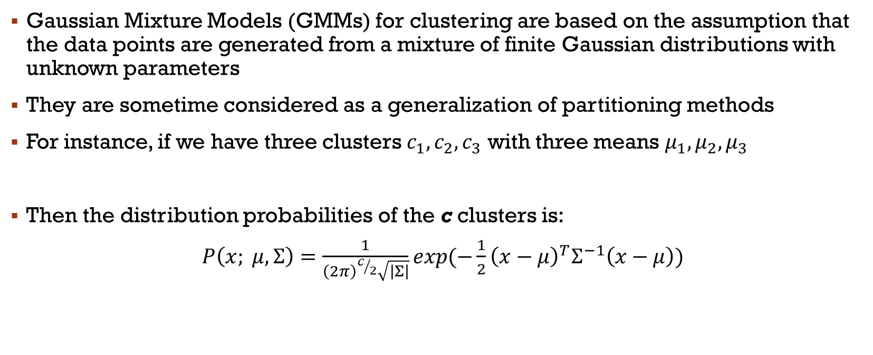
Gaussian Mixture
Gaussian Mixture Models (GMMs) for clustering are based on the assumption that the data points are generated from a mixture of finite Gaussian distributions with unknown parameters
They are sometime considered as a generalization of partitioning methods
For instance, if we have three clusters $c_{1}, c_{2}, c_{3}$ with three means $μ_{1},μ_{2},μ_{3}$
Then the distribution probabilities of the c clusters is:
$P\left(x; μ,Σ\right)=\frac{1}{{\left(2π\right)}^{c/2}\sqrt{\left|Σ\right|}}exp(−\frac{1}{2}{\left(x−μ\right)}^{T}Σ^{−1}\left(x−μ\right))$
Notes:
A Gaussian mixture model is a probabilistic model that assumes all the data points are generated from a mixture of a finite number of Gaussian distributions with unknown parameters.
Sigma matrice de covariance->mesure sur à quel point une seconde variable change en fonction d’une première
Souvent appelé Expectation-Maximization->algo itératif qui révise l’appartenance d’un point…probabilités!

Slide 20
Gaussian Mixture
For each cluster, the model estimates three parameters:
the mean vector (which indicates the cluster's center)
the covariance matrix (which indicates the cluster's shape and orientation)
the mixing coefficient (which indicates the cluster's size relative to the dataset)
GMM typically uses the Expectation-Maximization algorithm to estimate the parameters
It alternates between two steps:
Expectation (E-step): Calculate the probability that each data point belongs to each cluster, based on current parameter estimates
Maximization (M-step): Update the parameter estimates to maximize the likelihood of the data given these assignments

Slide 21
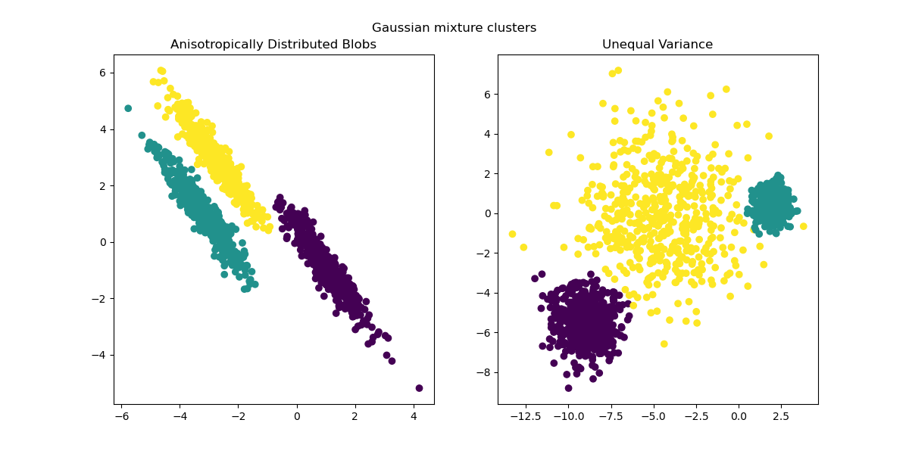
Gaussian Mixture
Gaussian Mixture can address the two problems we saw before

Slide 22
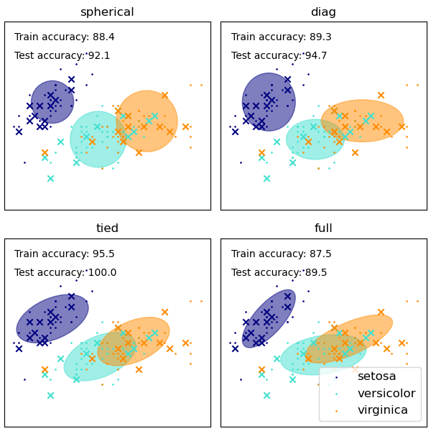
Score BIC
It can also draw confidence ellipsoids for multivariate models, and compute the Bayesian Information Criterion (BIC) to assess the number of clusters in the data
The GaussianMixture comes with different options to constrain the covariance of the difference classes estimated: spherical, diagonal, tied or full covariance.
Notes:
covariance_type: sperical->
Bic est un type de régularisation. BIC pénalise un nombre large de distribution Gaussienne…
Garder le modèle simple tout en expliquant les motifs de nos données

Slide 23
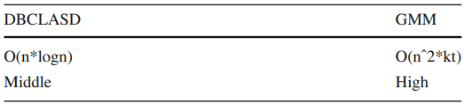
Other Distribution based algorithms
Distribution-Based Clustering of LArge Spatial Databases (DBCLASD):
DBCLASD is a dynamic incremental algorithm
if the distance between a cluster and its nearest data point satisfies the distribution of expected distance which is generated from the existing data points of that cluster, the nearest data point should belong to this cluster
Dirichlet/Poisson/Von Mises-Fisher Mixture Models:
There are several variations of GMM that simply use a different type of distributions
In practice, there is very little incentive to use something different than GMM unless you have an underlying knowledge of your data distribution

Slide 24
Main References
Russell S., Norvig P., Artificial Intelligence: A Modern Approach. Prentice-Hall, Englewood Cliffs, 2021.
Aggarwal, C. C., Neural networks and deep learning. Springer, 2023.
Goodfellow I., Bengio Y., Deep Learning. The MIT Press, 2016.
Raschka S., Python Machine Learning, Packt Publishing, 2015.
Sutton R.S., Barto A.G., Reinforcement Learning: An Introduction, A Bradford Book, 2021.
Witten I.H., Frank E., Hall M.A., Pal C. Data Mining: Practical Machine Learning Tools and Techniques, Morgan Kaufmann, 2016.

